Slide 1

Raspberry Pi Based System for Object Detection and Recognition for Visually Impared People
Guide-DR.S.JEEVA
Pidaparthi Agan Peter - RA1711003010930
Tanvi Jain - RA1711003010978
Batch ID - CSE09300978

Slide 2
Contents
Project Title
Abstract
Literature Survey
Problem Statement
UML Design
Block Diagram
Algorithms and Methodologies
Code
Result and Output
References

Slide 3
Abstract
Nowadays the demand of low cost well-trained embedded devices that can be applied in real world is increasing.Our efforts in this project are determined to achieve a system which can render one of such application to benefit the blind people. In this project video detection and recognition is presented based on a single board computer represented by Raspberry PI as an embedded solution. The aim is to make a smart system which detects the object for the blind user, measures its distance , and report the output in the form of audio signals to alert the blind user of the obstacle ahead. This entire work is done on raspberry pi with operating system ported on it.

Slide 4
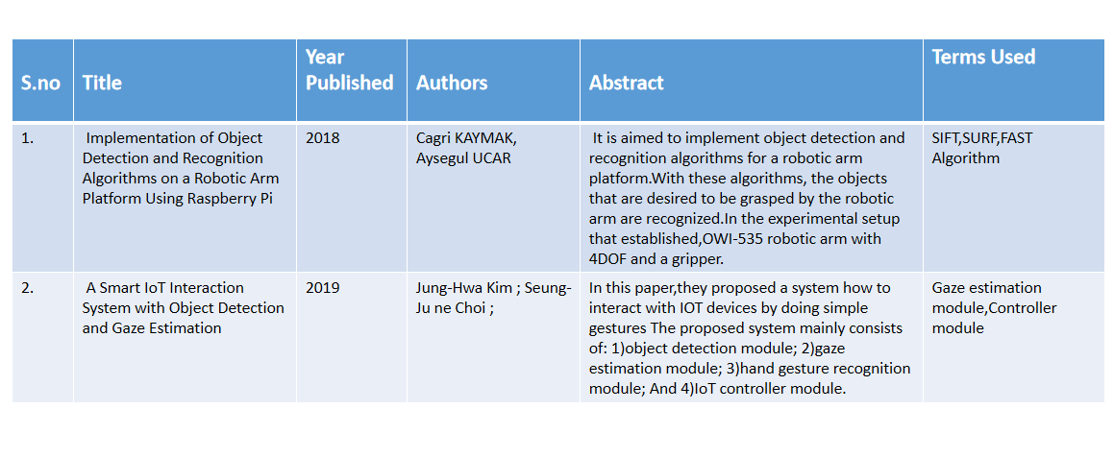
Literature Survey

Slide 5
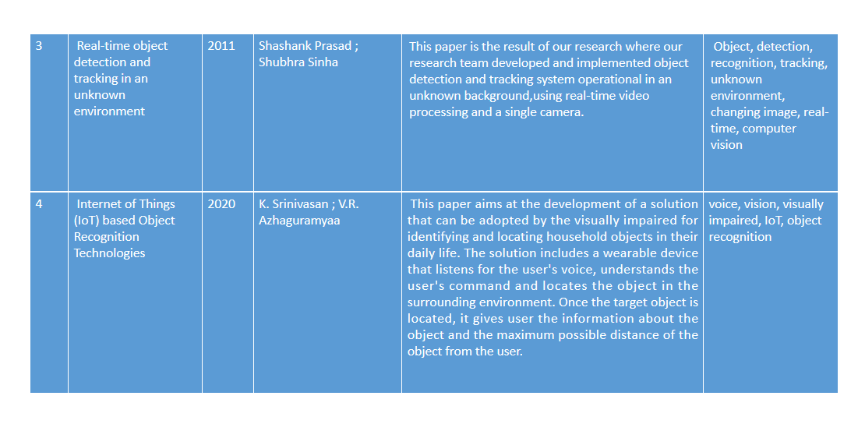

Slide 6
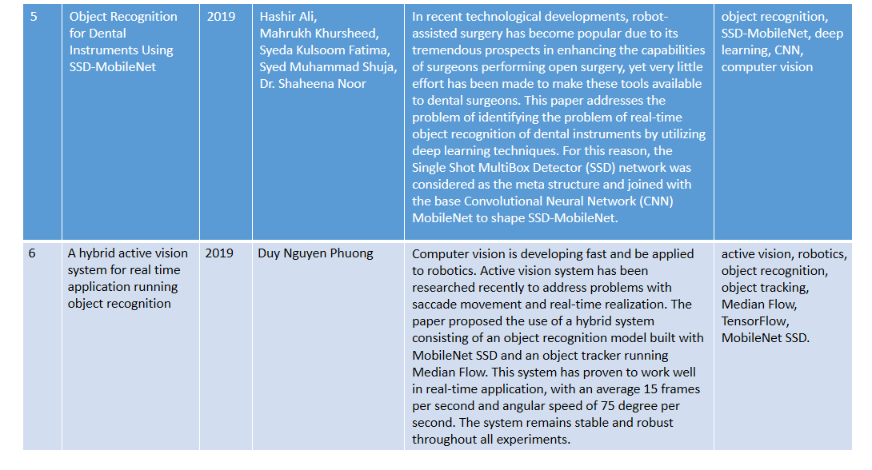

Slide 7
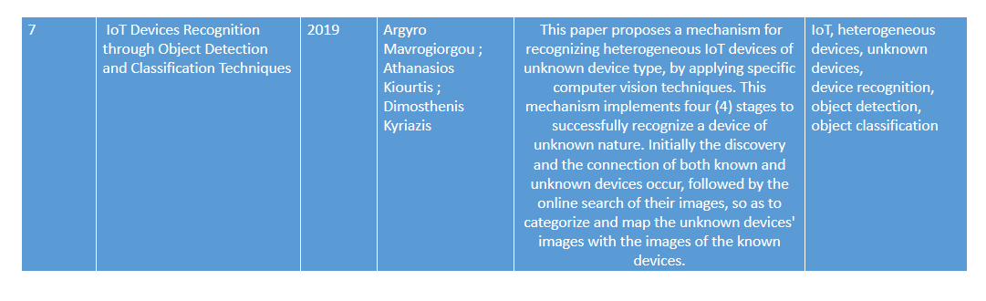

Slide 8
Introduction
People are witnessing the dawn of the new era of Deep Learning and embedded devices. Real life applications whether it be in the domain of Image recognition, Driver less cars, better preventive health care are all here today or on the horizon. The primary motivation which drives our team is how we can build a real-world application, in a cost effective manner which can benefit a section of society namely-”blinds”.

Slide 9
Problem Statement
One of the major problems faced by Blind people is detecting and recognizing an obstacle in their path. The projects approach lies in developing a system based on Raspberry Pi 3 , which is capable of labeling objects with the help of OpenCV and TensorFlow libraries and converting the labeled text to speech and producing output in the form of audio signals to make the blind person aware of the object in front of him. The scope also includes measurement of the distance of the object from the person and reporting the same. Most of the Object Detection algorithm has been tested on GPU with high computation abilities and are less likely to achieve same speed and accuracy with less powerful devices with microprocessor only, which are in high demand in current scenario. We choose Raspberry Pi 3 as our platform because it is a standard representative of embedded device and is widely being used for devising low cost-system. We would like to have a prototype that can successfully perform real-time detection in about 5-10 fps onPi, with decent accuracy.

Slide 10
Eminent Professor
Aysegul UCAR
agulucar@firat.edu.tr
OVERSEAS LAB
Mechatronics Engineering Department
Firat University
Elazig, Turkey

Slide 11
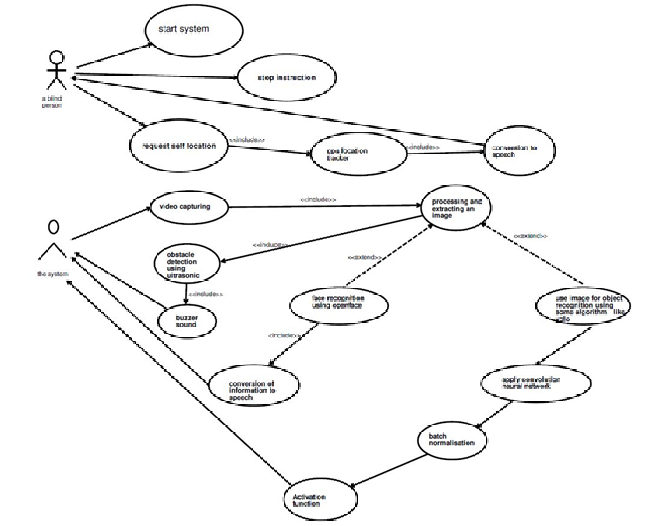
UML Diagram

Slide 12
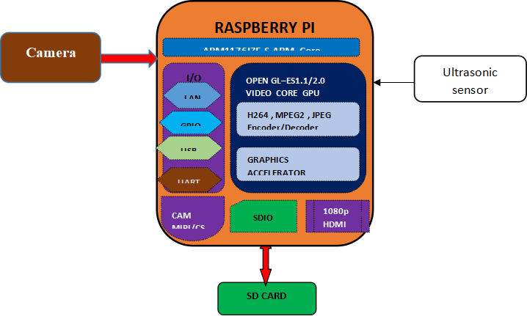
Block diagram

Slide 13
Algorithm and Methodologies
In this project, the Pre-trained model is used, Its accuracy is more than 90%. It can also be customized to recognize other objects using Transfer learning. The MobileNet is depth wise separable convolution, reduces the number of parameters. It is more suitable for vision-based applications where there is less performance power of the system.
MobileNets are the latest offering from Google. They are suitable for embedded and mobile devices because they have a small size, low latency and need low power. They can be used on platforms with resource constraints for various use cases. They can be used like some popular, but large scale, models such as Inception Net for the tasks of classification, detection and segmentation.

Slide 14
Usage of deep neural networks for object detection is also explored while keeping in mind the issue of porting the model to Raspberry Pi. Single Shot Multibox Detector (SSD) is also tested on the same dataset. It gives around 97% precision, but recall is low. The number of false positives reported is much less than that in traditional Computer Vision approaches explained before. But, the model needs a lot of memory to run.
MobileNets are the latest offering from TensorFlow that is suitable to be run on embedded and mobile devices. TensorFlow object detection API can be used to train and test such models with reduced memory requirements. It is shown that object detectors like SSD can be utilized for object detection task when coupled with MobileNets. Porting MobileNet model to a platform such as Raspberry Pi is the next logical step in that direction. This task is work in progress.

Slide 15
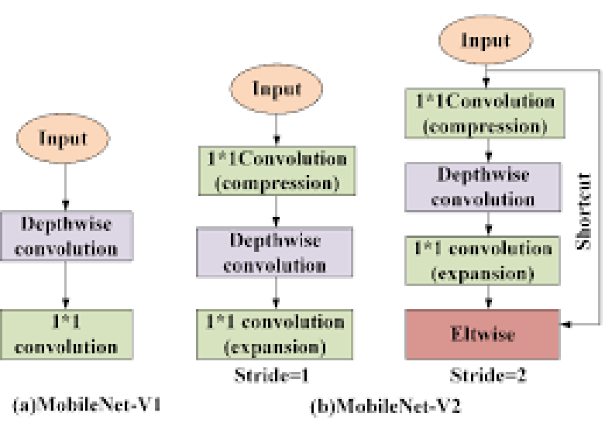
Algorithm Diagram

Slide 16
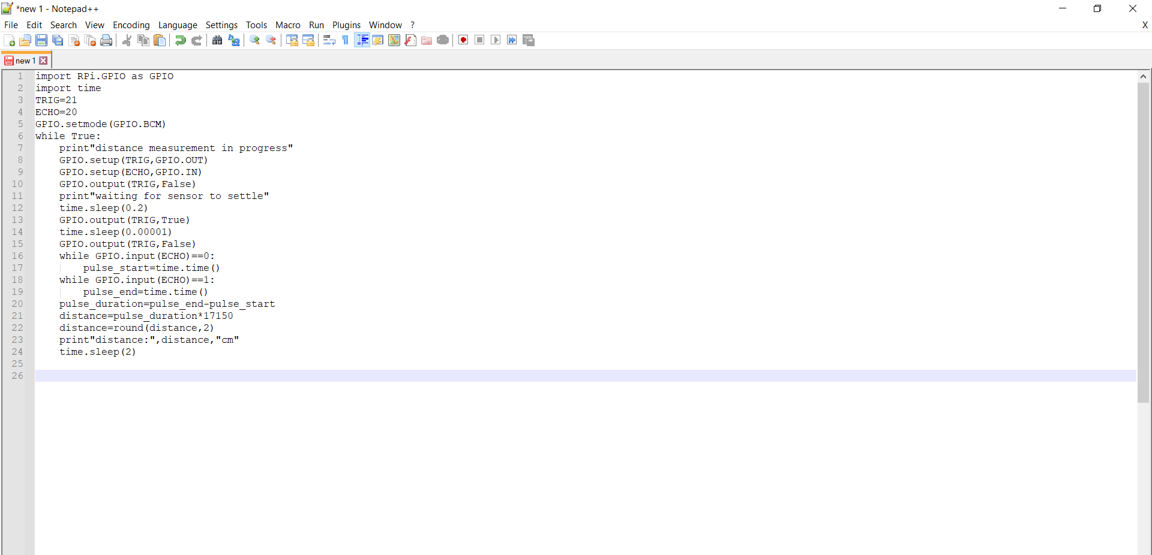
Code

Slide 17
Code Description
Input from a Sensor via GPIO:
The HC-SR04 distance sensor measures distance based on emitting a sound burst, and timing how long it takes to receive the echo back. Using the known constant that is the speed of sound, we can mathematically determine the distance of any object in front of this sensor by simply measuring how much time passed while the sound waves were emitted, hit the object in front of the sensor, bounced back, and came back to the sensor.

Slide 18
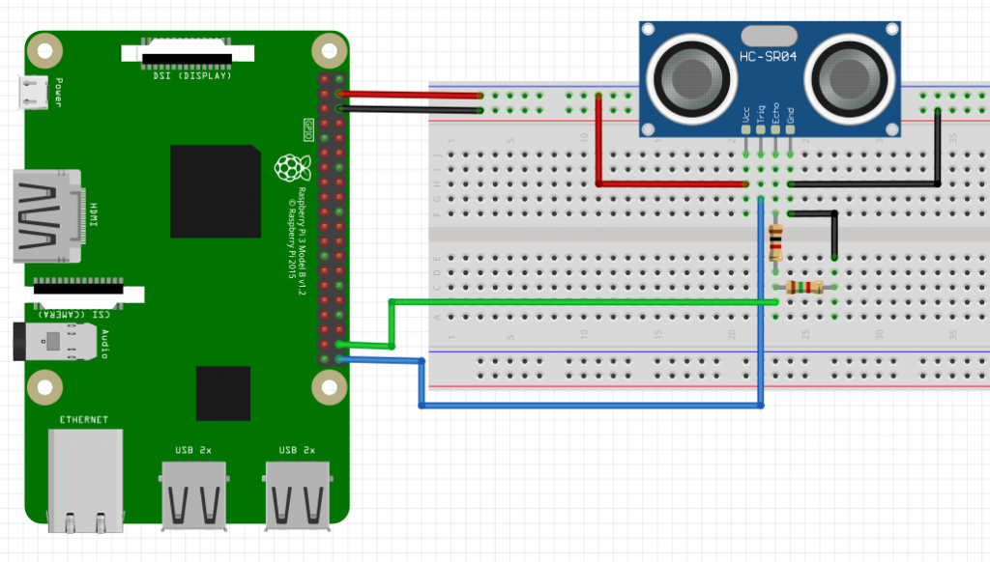
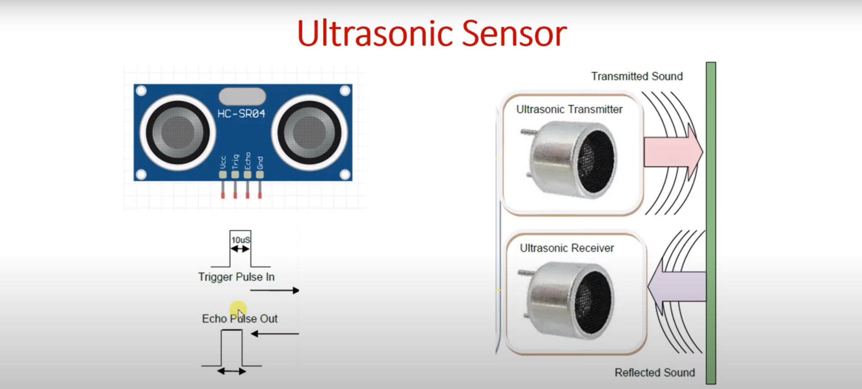

Slide 19
Result and Output
The project is going to contribute a foundation to work on embedded devices for object detection. It has contributed a lot to our knowledge as beginners in the fields of deep learning and embedded devices. From using the TensorFlow and OpenCV libraries , training and testing the system, embedding the code in Raspberry Pi, measuring the distance, to finally giving out the output to the blind person in the form of audio so that he can make himself aware what object is at what distance ahead, we have successfully build a real-world application from which someone can benefit.

Slide 20
REFERENCE
[1]C. KAYMAK and A. UCAR, "Implementation of Object Detection and Recognition Algorithms on a Robotic Arm Platform Using Raspberry Pi," 2018 International Conference on Artificial Intelligence and Data Processing (IDAP), Malatya, Turkey, 2018, pp. 1-8, doi: 10.1109/IDAP.2018.8620916.
[2] J. Kim, S. Choi and J. Jeong, "Watch & Do: A Smart IoT Interaction System with Object Detection and Gaze Estimation," in IEEE Transactions on Consumer Electronics, vol. 65, no. 2, pp. 195-204, May 2019, doi: 10.1109/TCE.2019.2897758.
[3] S. Prasad and S. Sinha, "Real-time object detection and tracking in an unknown environment," 2011 World Congress on Information and Communication Technologies, Mumbai, India, 2011, pp. 1056-1061, doi: 10.1109/WICT.2011.6141394.
[4] K. Srinivasan and V. R. Azhaguramyaa, "Internet of Things (IoT) based Object Recognition Technologies," 2019 Third International conference on I-SMAC (IoT in Social, Mobile, Analytics and Cloud) (I-SMAC), Palladam, India, 2019, pp. 216-220, doi: 10.1109/I-SMAC47947.2019.9032689.
[5] H. Ali, M. Khursheed, S. K. Fatima, S. M. Shuja and S. Noor, "Object Recognition for Dental Instruments Using SSD-MobileNet," 2019 International Conference on Information Science and Communication Technology (ICISCT), Karachi, Pakistan, 2019, pp. 1-6, doi: 10.1109/CISCT.2019.8777441.
[6]D. N. Phuong, "A hybrid active vision system for real time application running object recognition," 2019 2nd International Symposium on Devices, Circuits and Systems (ISDCS), Higashi-Hiroshima, Japan, 2019, pp. 1-5, doi: 10.1109/ISDCS.2019.8719101.
[7]A. Mavrogiorgou, A. Kiourtis and D. Kyriazis, "IoT Devices Recognition through Object Detection and Classification Techniques," 2019 Third World Conference on Smart Trends in Systems Security and Sustainablity (WorldS4), London, United Kingdom, 2019, pp. 12-20, doi: 10.1109/WorldS4.2019.8903926.

Slide 21
THANK YOU

